Slide 1
Introduction to the eFlows4HPC software stack and HPC Workflows as a Service methodology
Jorge Ejarque (BSC), Jedrzej Rybicki (JSC), Rosa M Badia (BSC)
EAB Meeting – Barcelona, 22nd of March 2023

Slide 2
Agenda
9:00 – 9:15 | Overview of eFlows4HPC project and tutorial agenda | Rosa M Badia (BSC)
9:15 - 9:35 | Part 1.1: Integrating different computations in PyCOMPSs | Rosa M Badia (BSC)
9:35 – 10:05 | Part 1.2: HPC ready container images | Jorge Ejarque (BSC)
10:05 - 10:35 | Part 1.3: Data Pipelines and Data Logistics Service (DLS) | Jedrzej Rybicki (JSC)
10:35 - 10:55 | Part 1.4: TOSCA Orchestration and HPCWaaS | Jorge Ejarque (BSC)
10:55 – 11:00 | Conclusion of part 1 | Rosa M Badia (BSC)
11:00 - 11:30 | Coffee break
11:30 - 12:05 | Part 2.1: Hands-on session: How to build HPC Ready containers | Jorge Ejarque (BSC)
12:05 - 12:30 | Part 2.2: Hands-on session: How to move data with the DLS | Jedrzej Rybicki (JSC)
12:30 - 12:45 | Part 2.3: Video demonstrating deployment with Allien4Cloud
12:45 - 13:00 | Tutorial conclusions | all presenters

Slide 3
Overview of eflows4HPC

Slide 4
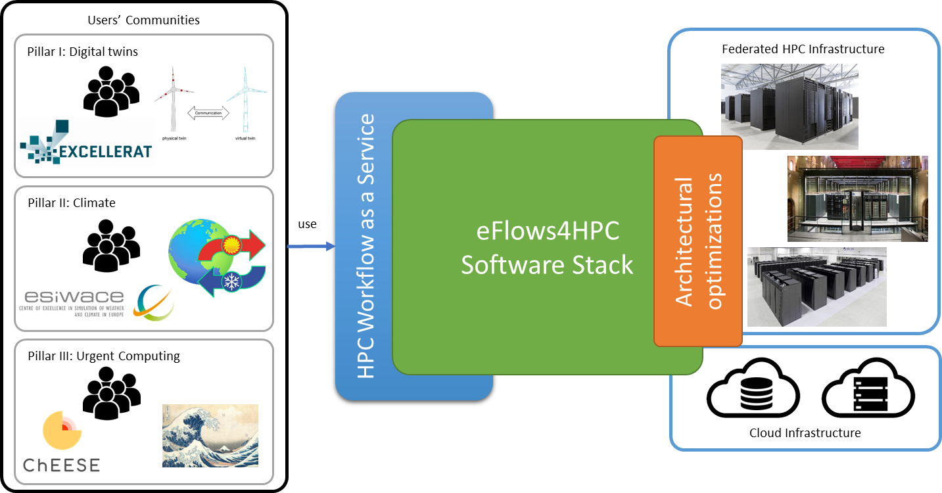
eFlows4HPC in a nutshell
Software tools stack that makes easier the development and management of complex workflows:
Combine different frameworks
HPC, AI, data analytics
Reactive and dynamic workflows
Autonomous workflow steering
Full lifecycle management
Not just execution
Data logistics and Deployment
HPC Workflows as a Service:
Mechanisms to make easier the use and reuse of HPC by wider communities
Architectural Optimizations:
Selected HPC – AI Kernels Optimized for GPUs, FPGA, EPI
Validation Pillar’s
End-user workflows linked to CoEs

Slide 5





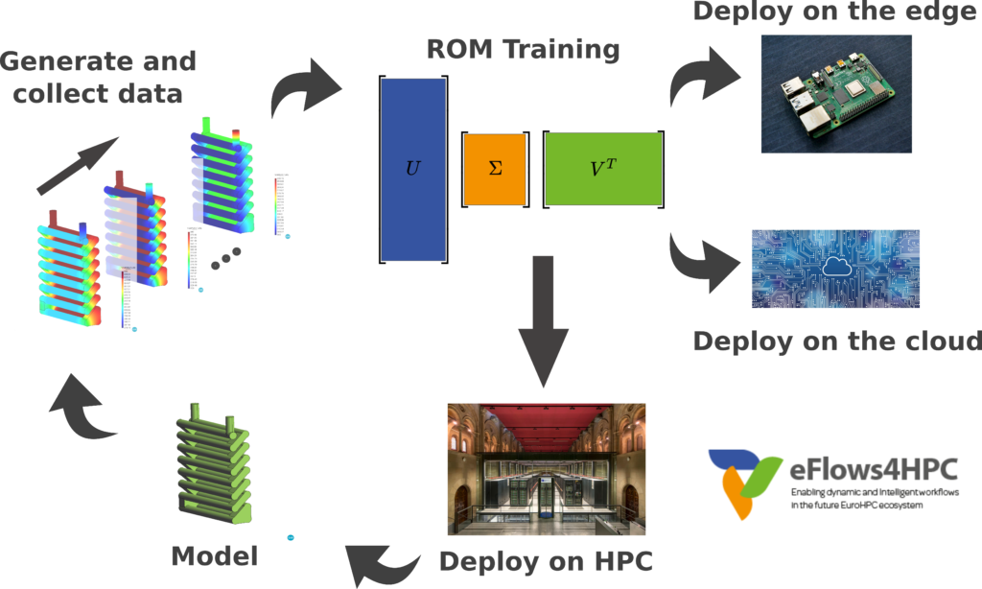
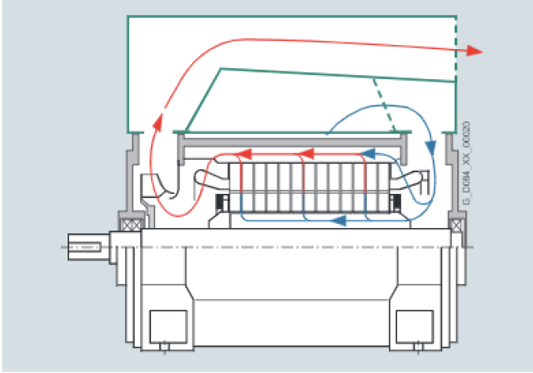

Pillar I: Manufacturing
Pillar I focuses on the construction of DigitalTwins for the prototyping of complex manufactured objects:
Integrating state-of-the-art adaptive solvers with machine learning and data-mining
Contributing to the Industry 4.0 vision
ParMMg
Full order models
validation
Notes:
Simulations with fine element models
SVD
Clustering
Training with neural networks

Slide 6

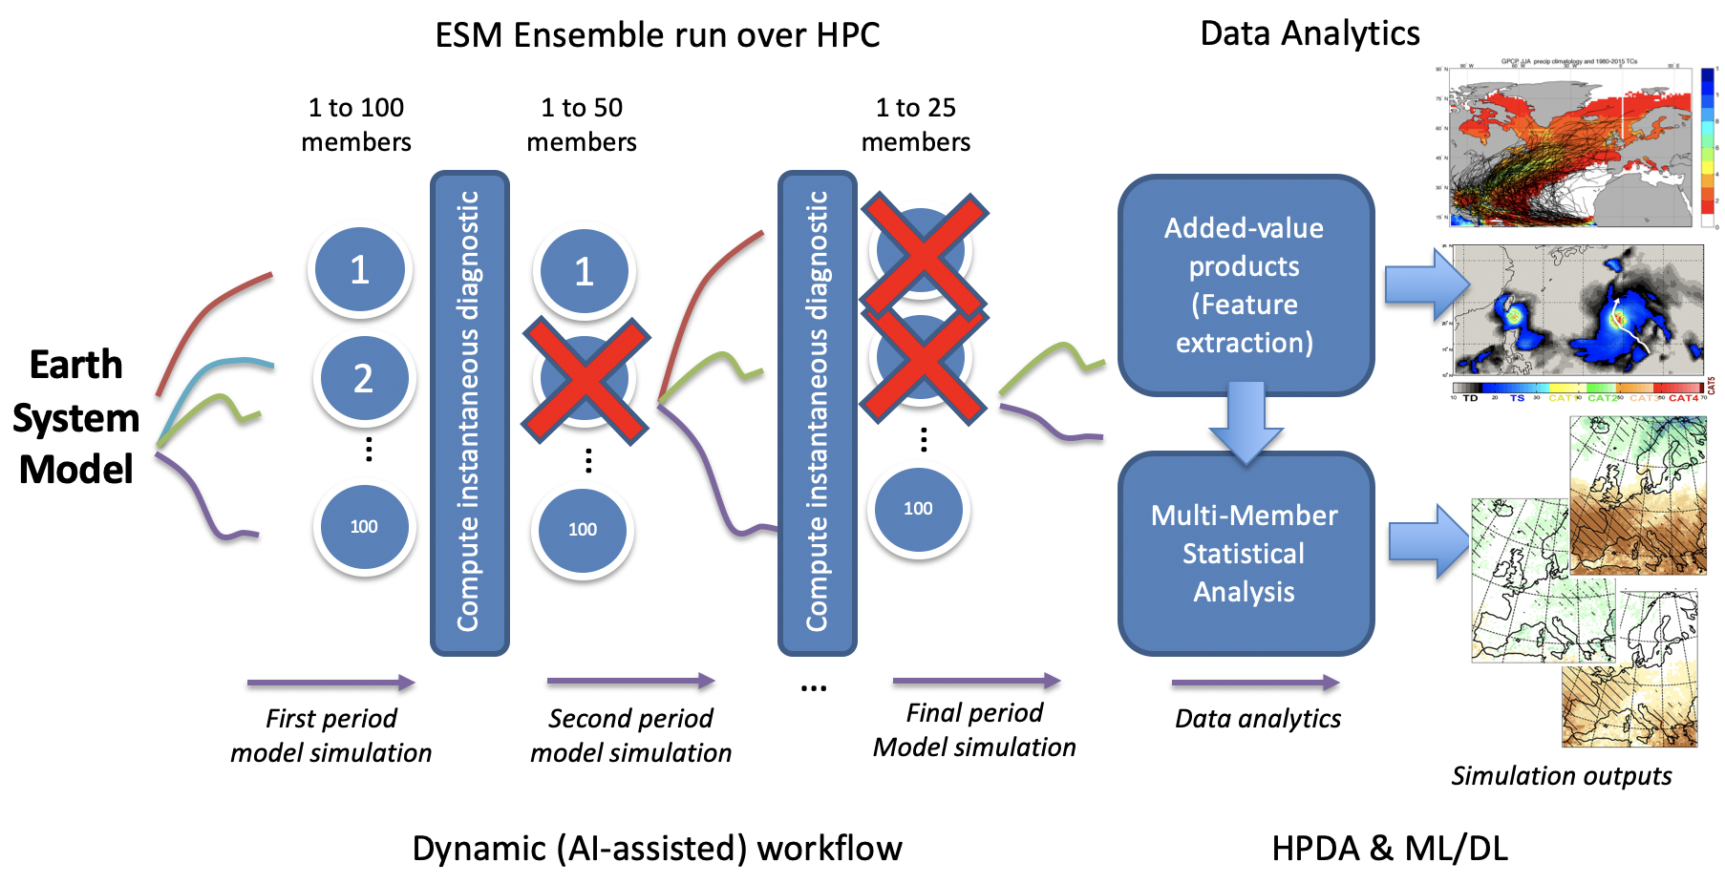
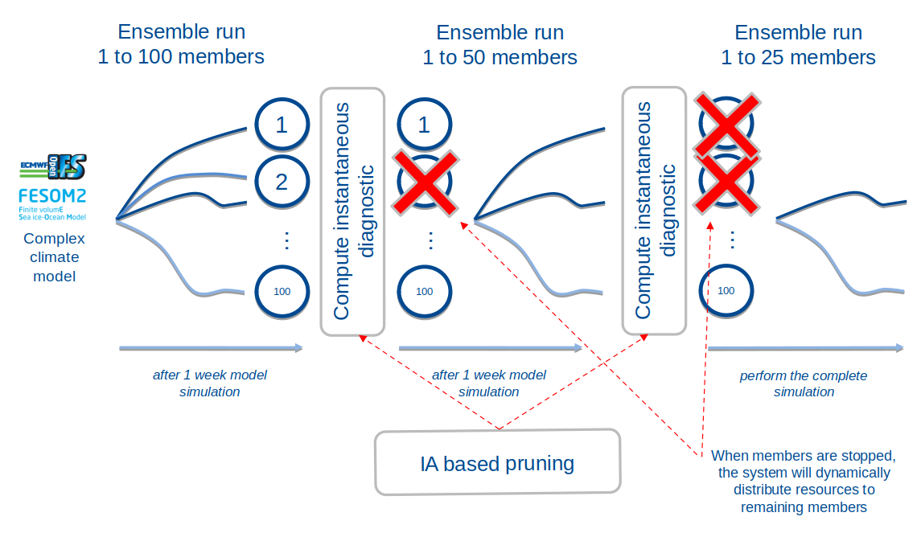


Pillar II: Climate
Perform climate predictions: temperature, precipitation or wind speed
AI-assisted pruning of the ESM workflow
Study of Tropical Cyclones (TC) in the North Pacific, with in-situ analytics
Notes:
Automatic selection of simulated ensemble members to adjust to the HPC capacities available
Tropical cyclones prediction based on ML/DL

Slide 7
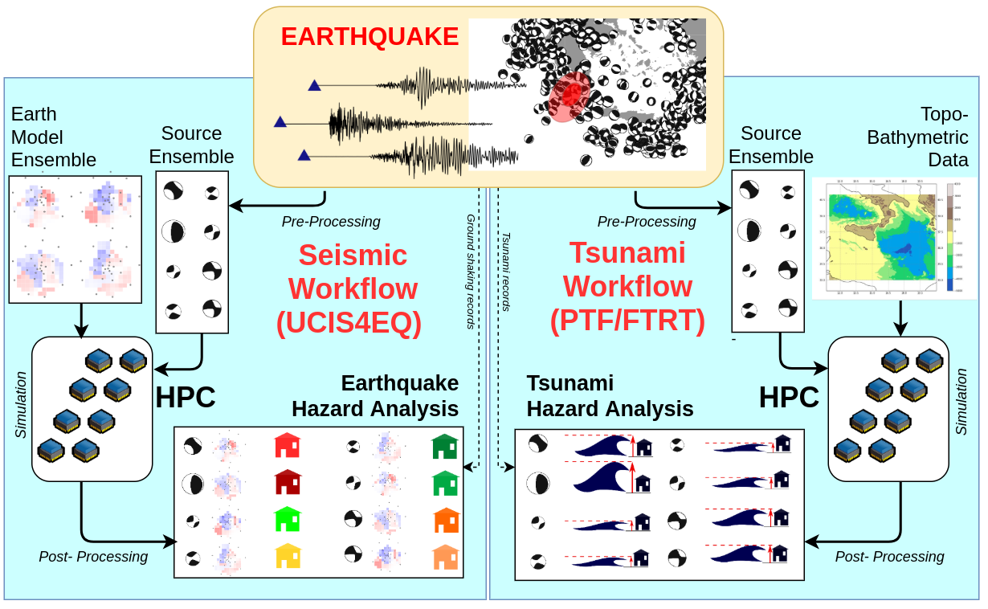
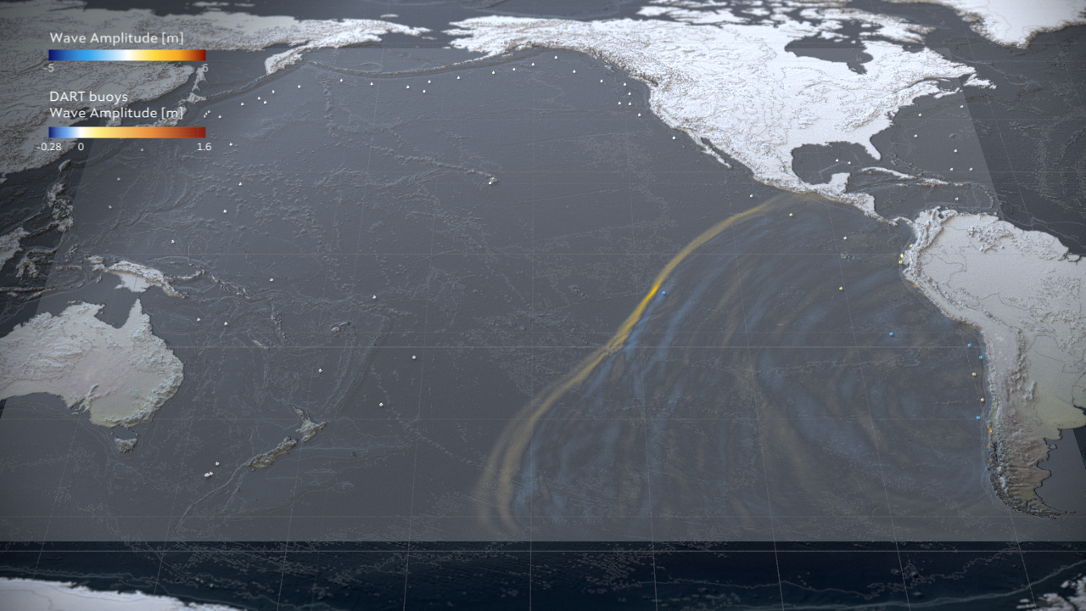





Pillar III: Urgent computing for natural hazards
Pillar III explores the modelling of natural catastrophes:
Earthquakes and their associated tsunamis shortly after such an event is recorded
Use of AI to estimate intensity maps
Use of DA and AI tools to enhance event diagnostics
Areas: Mediterranean basin, Mexico, Iceland and Chile
Tsunami-HySEA GPU-based code
Notes:
Seismic and tsunami urgent computing workflows consist of three main phases (Fig. \ref{fig:WP6_general_phases}):
- A pre-processing phase, in which an ensemble of possible sources is defined based on seismic data assimilation and earthquake parameter estimation, with uncertainty.
- A simulation phase, in which individual scenarios are simulated and ground shaking / tsunami inundation numerically quantified for all the scenarios in the ensemble
A post-processing phase, in which simulation results are processed to produce probabilistic forecasts including both source and modelling uncertainty, eventually updated through newly available observations from the monitoring networks
Probabilistic Tsunami Forecasting (PTF) for tsunami early-warning and urgent computing is based on the generation of an ensemble of Faster Than Real Time (FTRT) tsunami simulations
Tsunami-HySEA GPU-based soft-ware
use of AI for rapid tsunami estimation
use of HPDA and AI tools to enhance event diagnostics and in deeper postprocessing analyse

Slide 8
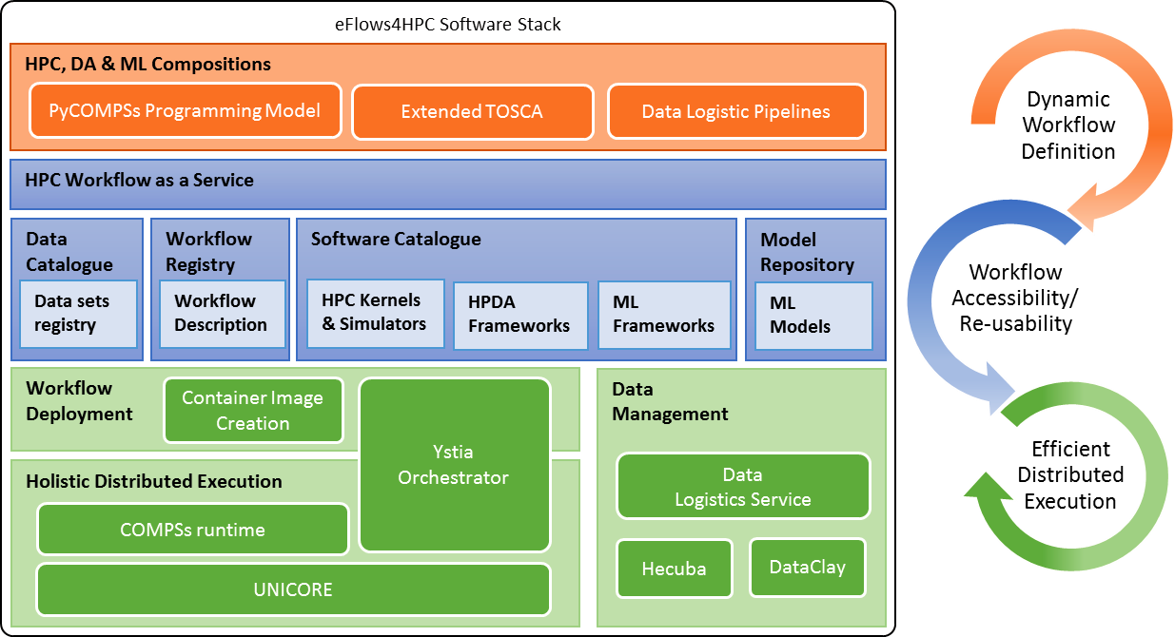

Slide 9



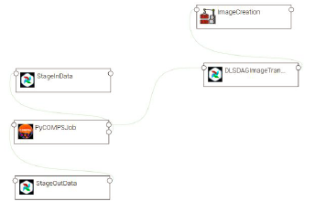
HPCWaaS Overview
Gateway Services
Data Catalogue
Software Catalogue
Workflow Registry
Alien4Cloud
Ystia Orchestrator
Execution API
Input/output datasets
Software Descriptions
5. execute
2. Store
3. Deploy
Dynamic Workflow Description
TOSCA Description
4. share
Data Logistics
Pipelines
PyCOMPSs Code
endpoint to invoke the Workflow
Create Workflow
Description of data movements as python functions.
Computational Workflow as a simple python script.
Topology of the components involved in the workflow lifecycle and their relationship.
Notes:
Just mention set of services to store workflows components data, software used at deployment and thw workflow description is composed by the data pipelines (acquisition of data set, AI modes, images) computational code with PyCOMPSs a task-based programming model which allow to implement distributed workflows as python scripts and TOSCA highlevel orchestrarion of the workflow lifecycle (deployment and execution of worflows and Pipelines)

Slide 10
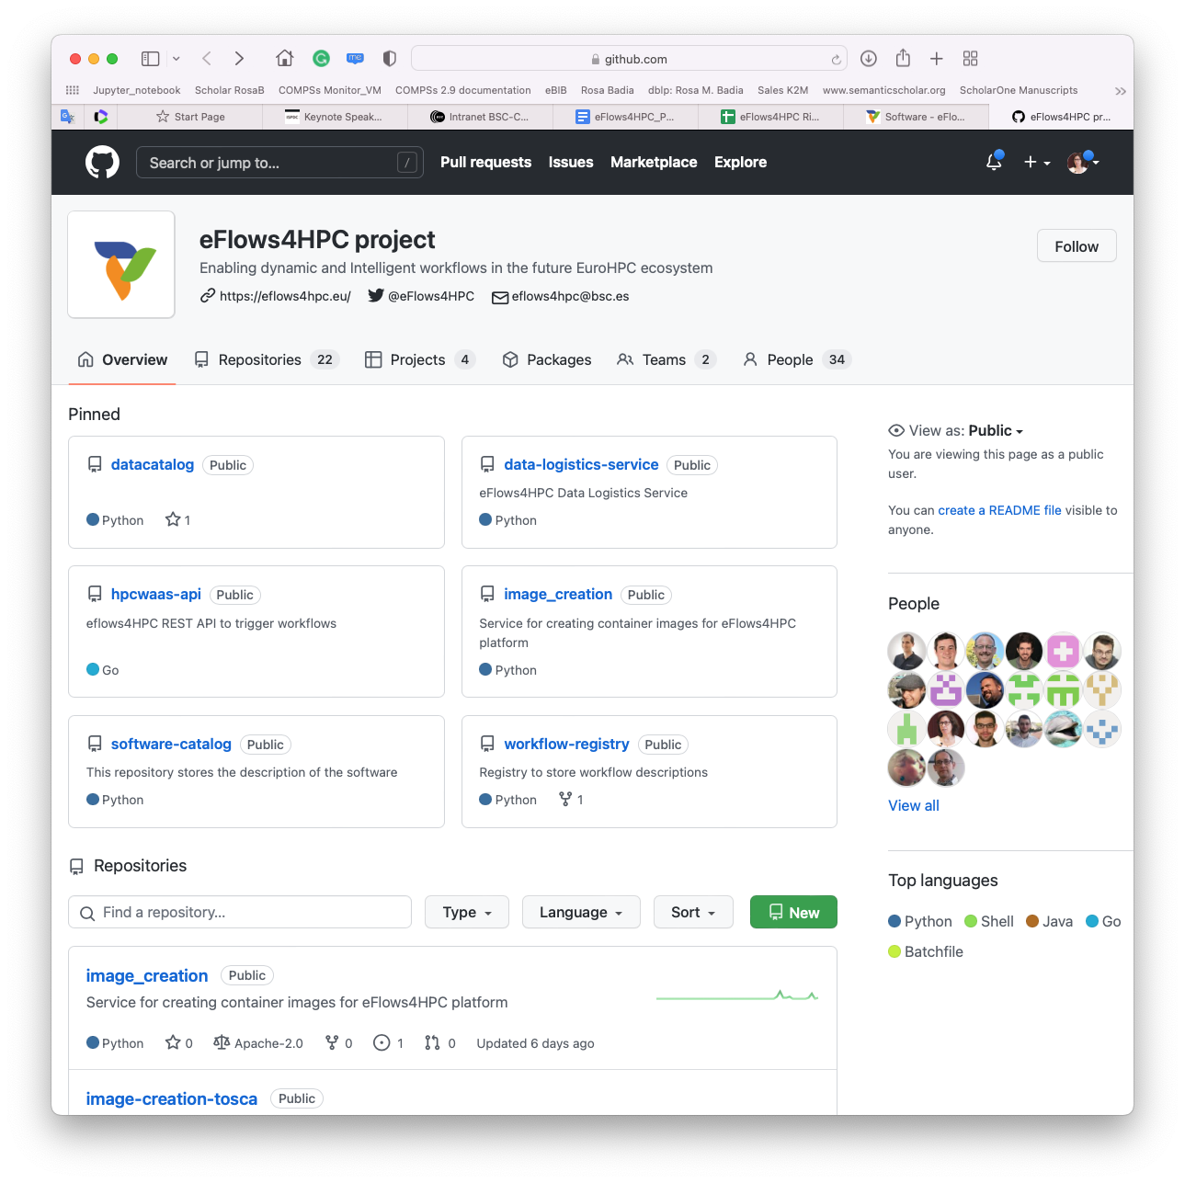
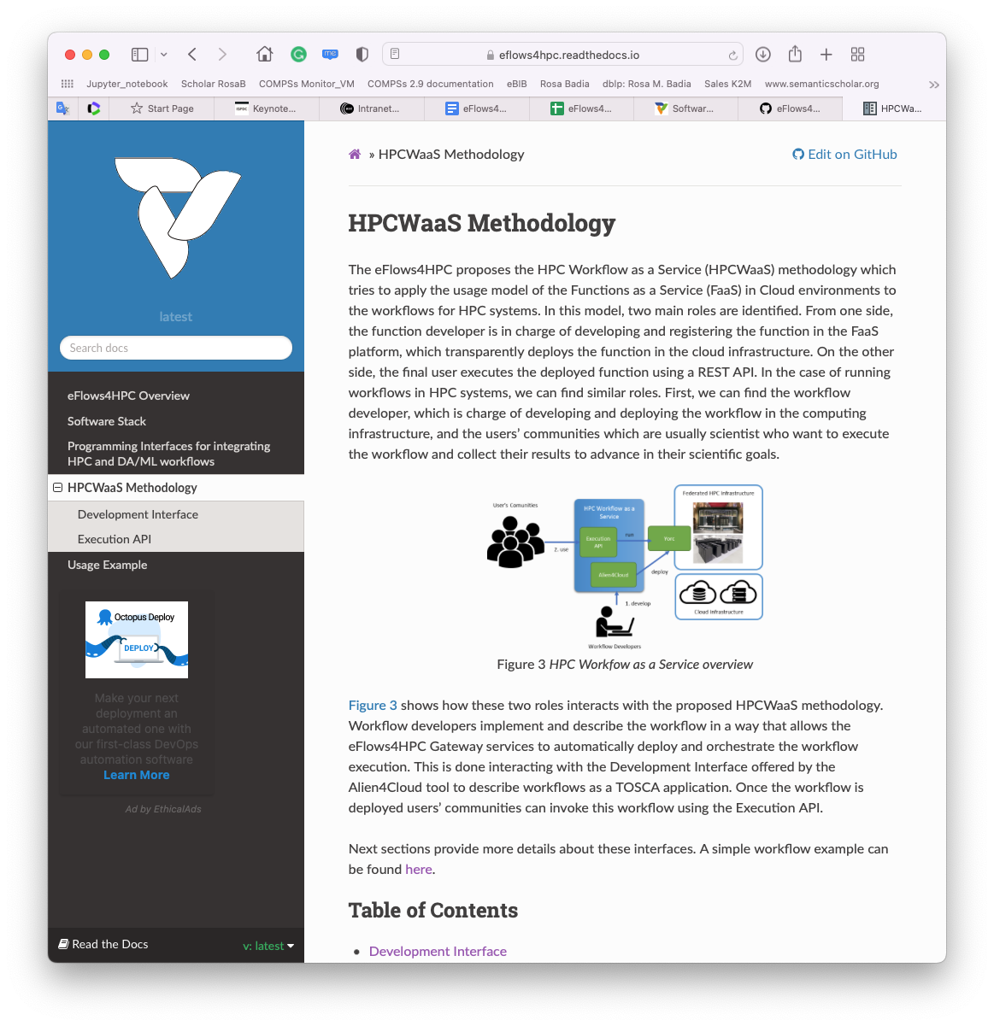
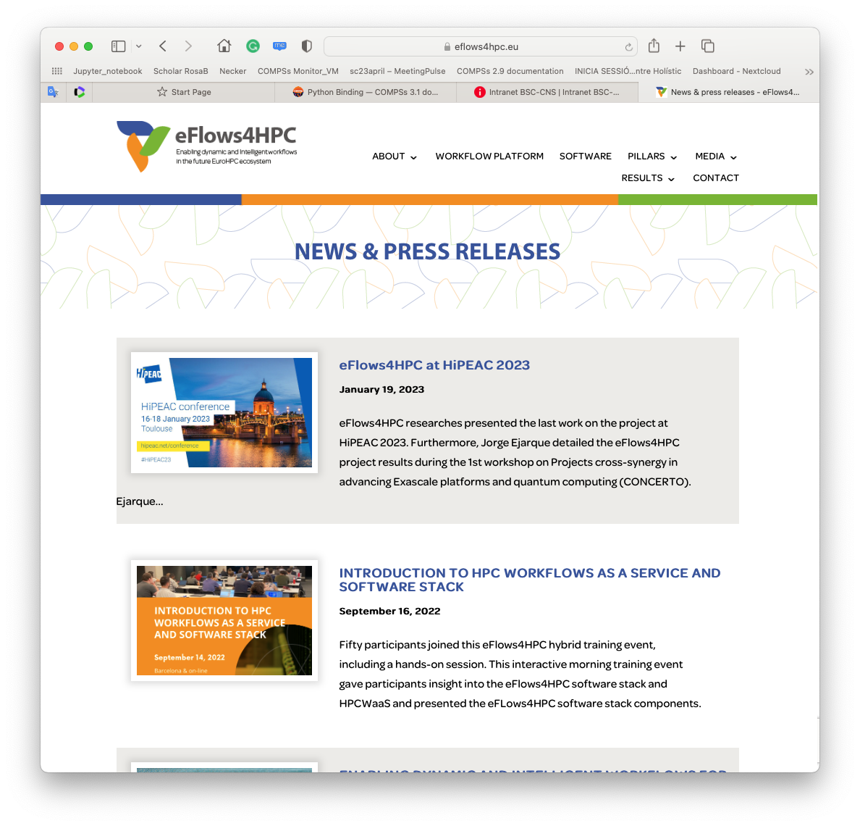
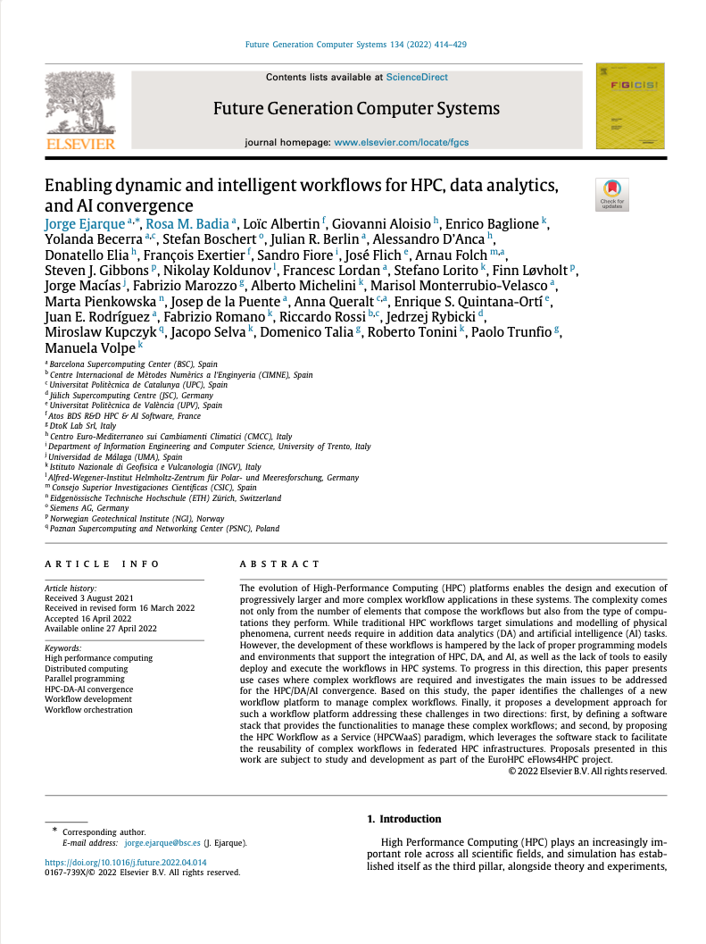
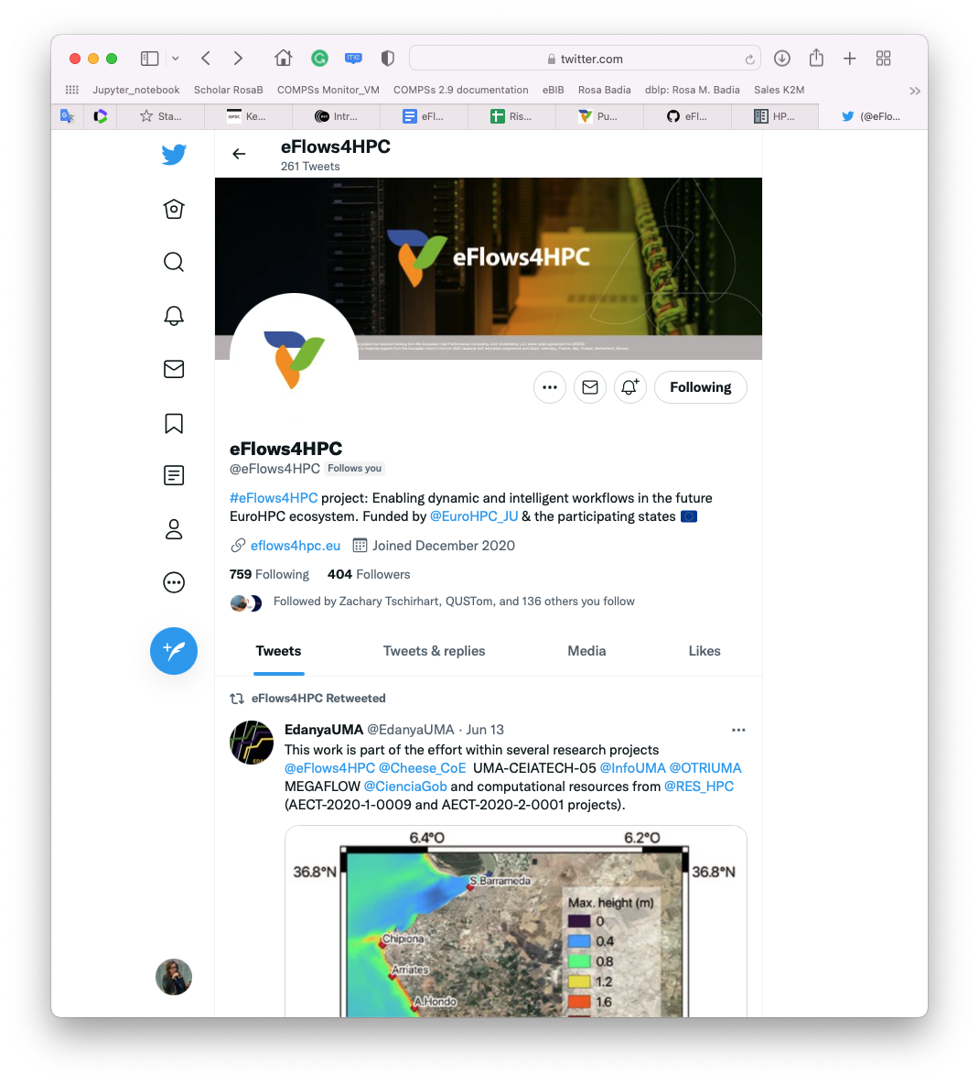
Project achievements
https://eflows4hpc.eu/software/
Requirements and software architecture. Reviewed at beginning of second iteration
Definition and implementation of abstractions to support the integration of different stack components
Design and development of a minimal workflow. Development of a step-by-step example.
Design and implementation of the HPCWaaS API
Design and implementation of project services: Data Catalogue, Workflow Registry, Software catalogue
Design and implementation of first version of Pillars’ workflows.
Two releases of project software and documentation available
Set of internal trainings about software stack components and HPCWaaS. ICS-HPC tutorial
Good visibility: articles, keynote presentations, media

Slide 11
Tutorial focus (I): HPC Workflows as a Service methodology
Part 1.1 How different type of computations (HPC modeling and simulation, artificial intelligence and data analytics) are combined
Part 1.2 How HPC specialized containers are generated
Part 1.3 How the required data transfers are specified and performed
Part 1.4 How the applications are deployed and top level workflow orchestrated

Slide 12
Tutorial focus (II): HPC Workflows as a Service methodology
Part 2.3 How to deploy applications with Alien4Cloud
Part 2.1 How to built HPC Ready containers
Part 2.2 How to move data with DLS

Slide 13

Project partners

Slide 14
Part 1.1: Integrating different computations in PyCOMPSs

Slide 15
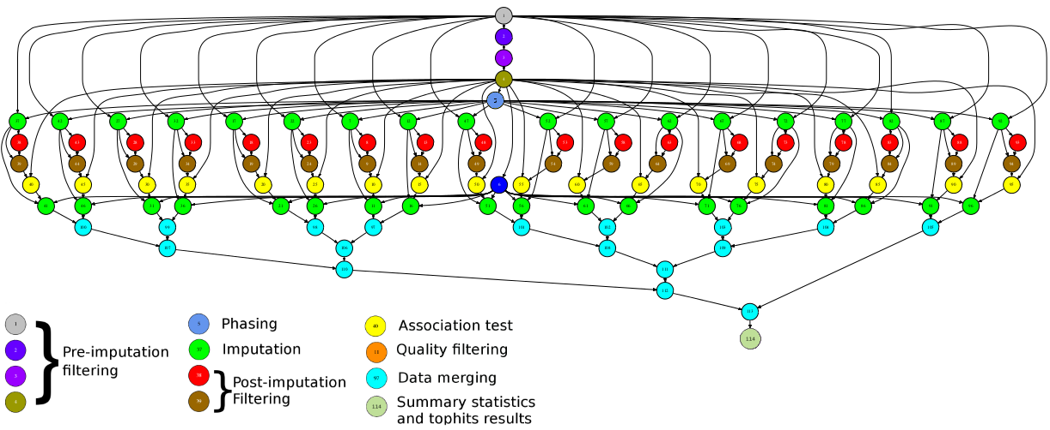
Main element: Workflows in PyCOMPSs
Sequential programming, parallel execution
General purpose programming language + annotations/hints
To identify tasks and directionality of data
Builds a task graph at runtime that express potential concurrency
Tasks can be sequential and parallel (threaded or MPI)
Offers to applications the illusion of a shared memory in a distributed system
The application can address larger data than storage space: support for Big Data apps
Support for persistent storage
Agnostic of computing platform
Enabled by the runtime for clusters, clouds and container managed clusters
@task(c=INOUT)
def multiply(a, b, c):
c += a*b

Slide 16

PyCOMPSs syntax
Use of decorators to annotate tasks and to indicate arguments directionality
Small API for data synchronization
Tasks definition
@task(c=INOUT)
def multiply(a, b, c):
c += a*b
Main Program
initialize_variables()
startMulTime = time.time()
for i in range(MSIZE):
for j in range(MSIZE):
for k in range(MSIZE):
multiply (A[i][k], B[k][j], C[i][j])
compss_barrier()
mulTime = time.time() - startMulTime

Slide 17
Synchronization
Main program and tasks do not share the same memory spaces
The synchronization compss_wait_on waits for tasks generating the parameter to be finished and moves the data from the remote node to the node where the main program is executed:
Tasks can be also synchronized with a barrier
a = compute (b)
#compute is a task, here we can not check the value of a
...
a = compss_wait_on (a)
#here we can check the value of a
if a:
...
startMulTime = time.time()
for i in range(SIZE):
compute (A[i], B[i])
compss_barrier()
mulTime = time.time() - startMulTime

Slide 18
Other decorators: Tasks’ constraints
Constraints enable to define HW or SW features required to execute a task
Runtime performs the match-making between the task and the computing nodes
Support for multi-core tasks and for tasks with memory constraints
Support for heterogeneity on the devices in the platform
@constraint (MemorySize=6.0, ProcessorPerformance=“5000”, ComputingUnits=“8”)
@task (c=INOUT)
def myfunc(a, b, c):
...
@constraint (MemorySize=1.0, ProcessorType =”ARM”, )
@task (c=INOUT)
def myfunc_other(a, b, c):
...
Notes:
Bogomips: En mobils bé estan al voltant de 38 i en laptops a mi em surt 5187

Slide 19
Failure Management
Interface than enables the programmer to give hints about failure management
Options: RETRY, CANCEL_SUCCESSORS, FAIL, IGNORE
Implications on file management:
I.e., on IGNORE, output files: are generated empty
Possibility of ignoring part of the execution of the workflow, for example if a task fails in an unstable device
Opens the possibility of dynamic workflow behaviour depending on the actual outcome of the tasks
Tasks can raise exceptions
Combined with groups of tasks enables to cancel the group of tasks on the occurrence of an exception
@task(file_path=FILE_INOUT)
def comp_task(file_path):
...
raise COMPSsException("Exception raised")
@task(file_path=FILE_INOUT, on_failure='CANCEL_SUCCESSORS’, time_out=‘$task_timeout’)
def task(file_path):
...
if cond :
raise Exception()
def test_cancellation(file_name):
try:
with TaskGroup('failedGroup’):
long_task(file_name)
long_task(file_name)
executed_task(file_name)
comp_task(file_name)
cancelledTask(FILE_NAME);
cancelledTask(FILE_NAME)
except COMPSsException:
print("COMPSsException caught")
write_two(file_name)
L
L
E
T
C
C

Slide 20
Other decorators: linking with other programming models
A task can be more than a sequential function
A task in PyCOMPSs can be sequential, multicore or multi-node
External binary invocation: wrapper function generated automatically
Supports for alternative programming models: MPI and OmpSs
Additional decorators:
@binary(binary=“app.bin”)
@mpi(binary=“mpiApp.bin”, runner=“mpirun”, processes=8)
@ompss(binary=“ompssApp.bin”)
Can be combined with the @constraint and @implement decorators
@binary(binary=“app.bin”, workingDir=“/myApp”)
@task()
def func(l):
pass
Notes:
We also provide other decorators that can be used over the task decorator in order to specify specific task implementations, such as mpi, binaries and OmpSs.
The runtime will be in charge of dealing with them.

Slide 21
Support for MPI tasks
Resource manager aware of multi-node tasks
@mpi (runner="mpirun", processes= ”32”, processes_per_node=8)
@task (returns=int, stdOutFile=FILE_OUT_STDOUT, stdErrFile=FILE_OUT_STDERR)
def nems(stdOutFile, stdErrFile):
pass
Node 0
Node 1
Node 2
Node 3
Launches MPI execution with 32 processes
8 processes per node

Slide 22
MPMD applications
The @mpmd_mpi decorator can be used to define Multiple Program Multiple Data (MPMD) MPI tasks
As a result of the @mpmd_mpi annotation, the following commands will be generated:
> cd working_dir_exe; mpirun -n $FESOM_PROCS fesom.x : \
-n $OIFS_PROCS oifs -v ecmwf -e awi3 : -n $RNFMA_PROCS rnfma
@mpmd_mpi(runner="mpirun", working_dir = {{working_dir_exe}},
programs=[{binary="fesom.x", processes = "$FESOM_PROCS" },
{binary="oifs", args="-v ecmwf -e awi3", processes = "$OIFS_PROCS" },
{binary="rnfma", processes = "$RNFMA_PROCS"}])
@task(log_file={Type:FILE_OUT, StdIOStream:STDOUT}, working_dir_exe=DIRECTORY_INOUT)
def esm_simulation(log_file, working_dir_exe):
pass

Slide 23
Tasks in container images
Goal: enable tasks embedded in container images
New @container decorator to be used together with the task annotation
Also supports user-defined tasks
@container(engine="DOCKER", image="ubuntu")
@binary(binary="ls")
@task()
def task_binary_empty():
pass
@container(engine="DOCKER", image="compss/compss")
@task(returns=1, num=IN, in_str=IN, fin=FILE_IN)
def task_python_return_str(num, in_str, fin):
print("Hello from Task Python RETURN")
print("- Arg 1: num -- " + str(num))
print("- Arg 1: str -- " + str(in_str))
print("- Arg 1: fin -- " + str(fin))
return "Hello"

Slide 24
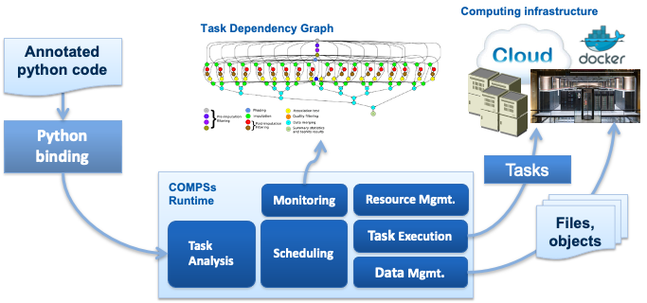
PyCOMPSs runtime
Support for tasks’ constraints – support for heterogeneous infrastructure
Support for tasks’ faults and tasks’ exceptions
Enlarges the dynamicity of the type of workflows that we support
Streamed data
... and many others
Runtime deployed as a distributed master-worker
All data scheduling decisions and data transfers are performed by the runtime
Support for elasticity

Slide 25
Interfaces to integrate HPC/DA/ML
Workflow
HPC Software
DA Software
ML Software
Data Transformation
Data Transformation
Simulation
Data Analytics
ML Training
Goal:
Reduce the required glue code to invoke multiple complex software steps
Developer can focus in the functionality, not in the integration
Enables reusability
Two paradigms:
Software invocation
Data transformations
#workflow steps defined as tasks
@data_transformation (input_data, transformation description)
@software (invocation description)
def data_analytics (input_data, result):
pass
#workflow body
simulation (input_cfg, sim_out)
data_analytics (sim_out, analysis_result)
ml_training (analysis_result, ml_model)

Slide 26
Software Invocation description
Workflow Code
Computing Infrastructure
Admin/user code
{
"type":"mpi",
"properties":{
"runner": "mpirun",
“processes”: “$SW_PROCS”
"binary": "mpi_sofware.x",
"params": "-d {{param}}",
“working_dir”: “{{working_dir}}”},
"prolog":{
"binary":"mkdir",
"params":"{{working_dir}}"},
"epilog":{
"binary":"tar",
"params":"zcvf {{out_tgz}}" {{working_dir}}},
"constraints":{
"computing_units": $SW_THREADS}
}
PyCOMPSs Code
COMPSs runtime
Software Invocation
User code
Automatically generated
#workflow steps defined as tasks
@software(config_file="invocation.json")
def mpi_exec(work_dir, param, out_tgz):
pass
#workflow body
...
mpi_exec('my_folder', 'hello_world’)
...
mkdir working_dir
cd working_dir
export OMP_NUM_THREADS=$SW_THREADS
mpirun -n $SW_PROCS mpi_software.x -d param
tar zcvf out_tgz working_dir
Software invocation description
Stored in software catalog
Converts a Python function of a software invocation to a PyCOMPSs task
Takes information from the description in json
Enables reuse in multiple workflows

Slide 27
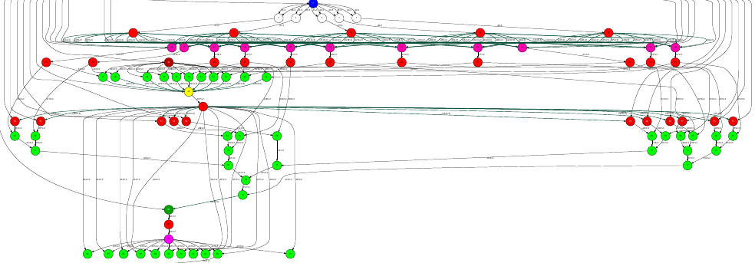
Data transformations
A data transformation changes the data without requiring extra programming from the developer
Admin/user code
def load_blocks_rechunk(blocks, shape, block_size, new_block_size):
...
SnapshotMatrix = load_blocks_array (final_blocks, shape, block_size);
return SnapshotMatrix
@dt("blocks", load_blocks_rechunk, shape=expected_shape, block_size=simulation_block_size,
new_block_size=desired_block_size, is_workflow=True)
@software(config_file = SW_CATALOG + "/dislib/dislib.json")
def rSVD(blocks, desired_rank=30):
u,s = rsvd(blocks, desired_rank, A_row_chunk_size, A_column_chunk_size)
return u
User code
...
model, parameters = load_model_parameters(model_file)
for cfg in sim_cfgs:
sim_results.append(execute_FOM_instance(model,parameters,[cfg]))
rom = rSVD(sim_results, desired_rank)
...
dt
User code
Main workflow program

Slide 28
Pillar I: Integration of HPC and data analytics in a single workflow
{
"execution" : {
"type":"task"
},
"constraints" : {
"computing_units": "$KRATOS_CUS"
},
"parameters" : {
"returns" : 1,
"model" : "IN",
"parameters" : "IN",
"sample" : "IN"
}
}
fom.json
@software(config_file = SW_CATALOG+"/kratos/fom.json")
def execute_FOM_instance(model,parameters, sample):
import KratosMultiphysics
from kratos_simulations import RunROM_SavingData
load_ROM(rom)
current_model = KratosMultiphysics.Model()
model.Load("ModelSerialization",current_model)
del(model)
current_parameters = KratosMultiphysics.Parameters()
parameters.Load("ParametersSerialization",current_parameters)
del(parameters)
simulation = RunROM_SavingData(current_model,current_parameters,sample)
simulation.Run()
return simulation.GetSnapshotsMatrix()

Slide 29
Posar quina forma tenen les dades?

Slide 30
Pillar I: Integration of HPC and data analytics in a single workflow
@dt("blocks", load_blocks_rechunk, shape=expected_shape, block_size=simulation_block_size,
new_block_size=desired_block_size, is_workflow=True)
@software(config_file = SW_CATALOG + "/py-dislib/dislib.json")
def rSVD(blocks, desired_rank=30):
from dislib_randomized_svd import rsvd
u,s = rsvd(blocks, desired_rank, A_row_chunk_size, A_column_chunk_size)
return

Slide 31
Pillar I: Integration of HPC and data analytics in a single workflow
import dislib as ds
@dt("blocks", load_blocks_rechunk, shape=expected_shape, block_size=simulation_block_size,new_block_size=desired_block_size, is_workflow=True)
@software(config_file = SW_CATALOG + "/dislib/dislib.json")
def rsvd(blocks, desired_rank):
k = desired_rank
...
Y = A @ Omega
Q,R = my_qr(Y._blocks)
Q=load_blocks_rechunk([Q], ...)
...
B = Q.T @ A
...
@software(config_file=kratos.json)
def ExecuteInstance (model, parameters, Cases, instance):
...
current_parameters = KratosMultiphysics.Parameters()
...
simulation = GetTrainingData(current_model,current_parameters,sample)
simulation.Run()
return simulation.GetSnapshotsMatrix()
....
for instance in range (0,TotalNumberOFCases):
blocks.append(ExecuteInstance(model, parameters, pars, instance))
...
U, s = rSVD(A, desired_rank)
...

Slide 32
Pillar I: Integration of HPC and data analytics in a single workflow
import dislib as ds
@dt("blocks", load_blocks_rechunk, shape=expected_shape, block_size=simulation_block_size,new_block_size=desired_block_size, is_workflow=True)
@software(config_file = SW_CATALOG + "/dislib/dislib.json")
def rsvd(blocks, desired_rank):
k = desired_rank
...
Y = A @ Omega
Q,R = my_qr(Y._blocks)
Q=load_blocks_rechunk([Q], ...)
...
B = Q.T @ A
...
@software(config_file=kratos.json)
def ExecuteInstance (model, parameters, Cases, instance):
...
current_parameters = KratosMultiphysics.Parameters()
...
simulation = GetTrainingData(current_model,current_parameters,sample)
simulation.Run()
return simulation.GetSnapshotsMatrix()
....
for instance in range (0,TotalNumberOFCases):
blocks.append(ExecuteInstance(model, parameters, pars, instance))
...
U, s = rSVD(A, desired_rank)
...

Slide 33
Given more details about the Pillar I workflow
Results of the simulations
Data transformation
@software annotation

Slide 35
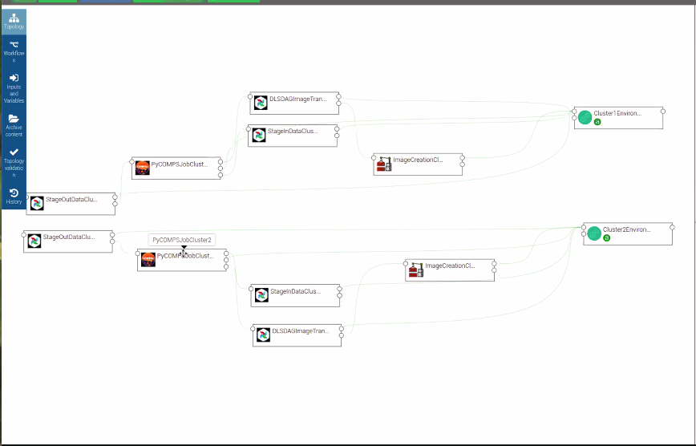

Slide 36
Exemple de dt
Neural network
Un transposada -> els de SISSA
Marisol (?)
fitxer -> agafar columnes
Filtre de cada fitxer els que es passen d’un cert parametre

